Slide 1
GDP Analysis
By: Hemant Sawakare
Date: 07/30/2019
Roll Number -DDS1930106

Slide 2
Problem Statement
Analyze and compare the GDPs of various Indian states (both total and per capita).
Data Exploration
Source: https://data.gov.in/ - an Open Government Data (OGD) platform of India.
Divide the states into four categories based on the GDP per capita, and for each of these four categories, analyze the sectors that contribute the most to the GDP (such as agriculture, real estate, manufacturing, etc.).
Analyze whether GDP per capita is related to dropout rates in schools and colleges.
Provide state specific recommendations, if any, to improve GDP.
Datasets:
State-wise Gross Domestic Product (GDP) at current price on yearly basis
GSVA by Economic Activity at Current Prices
Dropout rates data

Slide 3
State-wise Gross Domestic Product (GDP) at current price on yearly basis:
Contains data for 28 states and 4 union territories
Data for West Bengal is not available (Excluded from analysis)
GSDP - CURRENT PRICES (` in Crore) for Year 2011 thru 2017
GSDP is in Crores
(% Growth over previous year) for Year 2011 thru 2017
GSVA by Economic Activity at Current Prices:
Data available as individual datasets for 28 states and 4 union territories
Data represents GDP contribution by various Sectors/Sub-Sectors
Per Capita GSDP is available for various years.
GSDP is in lacks
Dropout rates data :
Contains drop out rates for Primary, Upper Primary, Secondary and Senior Secondary class.
Data is available for 2012 thru 2015
Primary 2014-2015 occurs twice in the data. This appears to be Typo - First occurrence appears to be Primary 2013-2014. We will ignore the first occurrence and consider second occurrence (Primary - 2014-2015.1) for our processing

Slide 4
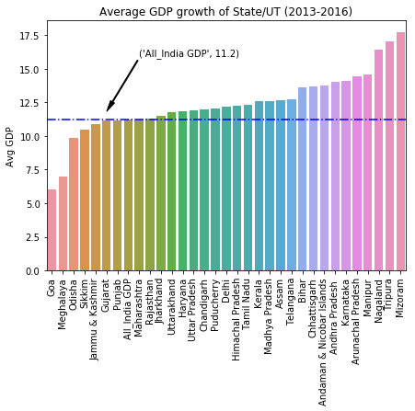
Average '(% Growth over previous year)’ for the duration 2013-14, 2014-15 and 2015-16
There is no data for West Bengal.
Mizoram, Tripura, Nagaland, Manipur and Arunachal Pradesh have the highest average GDP growth over previous year.
Goa, Meghalaya, Odisha, Sikkim and J&K have the lowest average GDP growth.
Goa, Meghalaya, Odisha, Sikkim, J&K, and Gujrat are below Nation average GDP growth.
Note – Union Territories are included in the analysis.

Slide 5
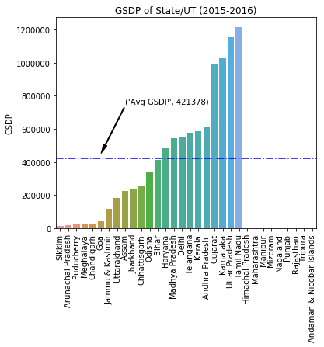
Total GDP of the states for the year 2015-16
Tamil Nadu, Uttar Pradesh, Karnataka, Gujarat and Andhra Pradesh have the highest GDP.
Chandigarh, Meghalaya, Puducherry, Arunachal Pradesh and Sikkim have the lowest GDP.
There is no data to plot for below states
West Bengal.
Himachal Pradesh
Maharashtra
Manipur
Mizoram
Nagaland
Punjab
Rajasthan
Tripura
Andaman & Nicobar Islands
Note – Union Territories are included in the analysis.

Slide 6
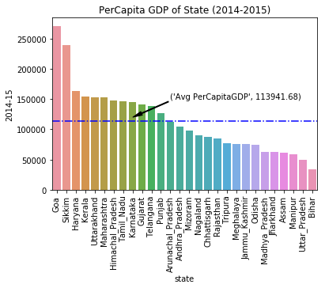
GDP per capita for all the states for the year 2014-15
Top 5 states with Per Capital GDP are - Goa, Sikkim, Haryana, Kerala and Uttarakhand.
Bottom 5 states with Per Capital GDP are - Bihar, Uttar Pradesh, Manipur, Assam and Jharkhand.
Ratio of the highest per capita GDP (Goa) to the lowest per capita GDP (Bihar) is 8.0
Union Territories are not considered for the analysis
Ratio of the highest per capita GDP (Goa) to the lowest per capita GDP (Bihar) is 8.0.

Slide 7
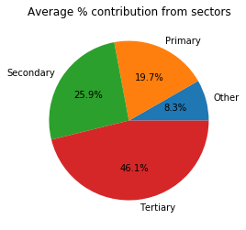
% GDP Contribution from sectors (2014-15).
Overall contribution from Tertiary sector is higher followed by Secondary and Primary.
Note - For simplicity We are deriving a field “others” = Taxes on Products - Subsidies on products
Only Sikkim, Chhattisgarh, Gujrat, Nagaland and Uttarakhand have higher contribution from Secondary sector.

Slide 8
Categorize Data for Analysis
Quantile Calculation
Category1 - Greater than 85 percentile
Category2 - Greater than 50 and Less than or equal to 85 percentile
Category3 - Greater than 20 and Less than or equal to 50 percentile
Category4 - Less than or equal to 20 percentile

Slide 9
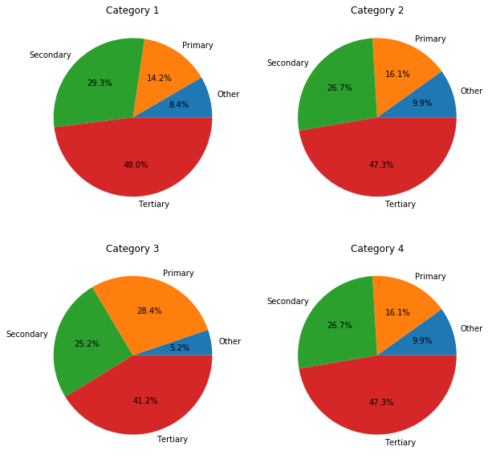
% GDP Contribution by sectors for all Categories (2014-15)
These top 6 sub-sectors contribute to approximately 80% of the GDP
Manufacturing
Agriculture, forestry and fishing
Trade, repair, hotels and restaurants Manufacturing
Real estate, ownership of dwelling & professional services
Construction
Taxes on Products
Derived field “Other” represents “Taxes on Products” – “Subsidies on products”
Contribution from individual states on next slide.

Slide 10
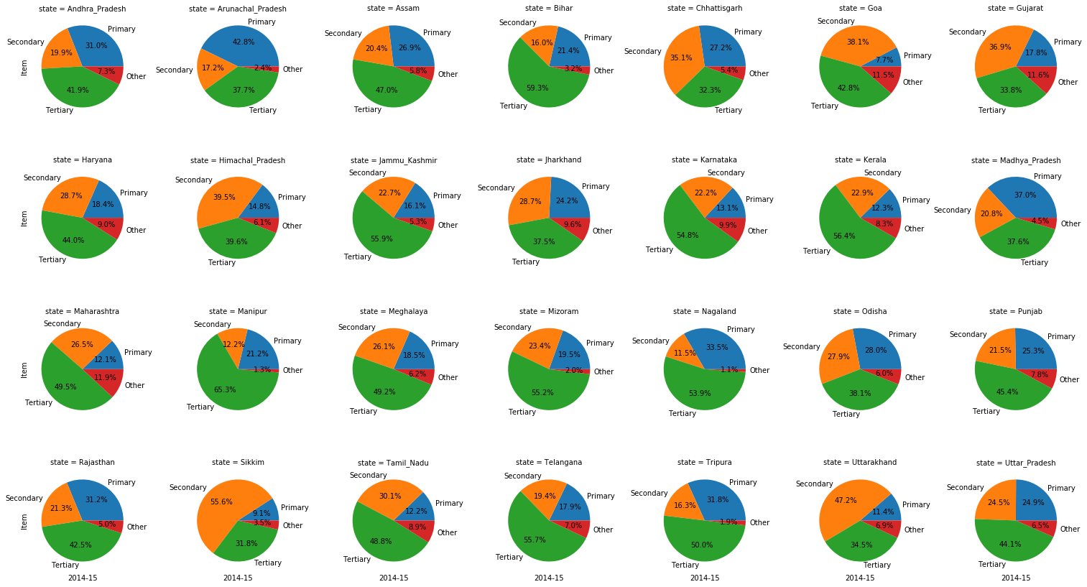
% Contribution from individual states (2014-15)

Slide 11
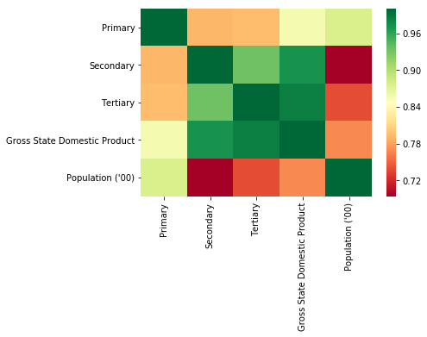
Correlation between sectors (Duration – 2014-15)
Observations:-
GDP rises with increase in contribution from Tertiary sector (Strongly correlation )
GDP is weakly correlated to population
Moderate correlation between secondary and tertiary section

Slide 12
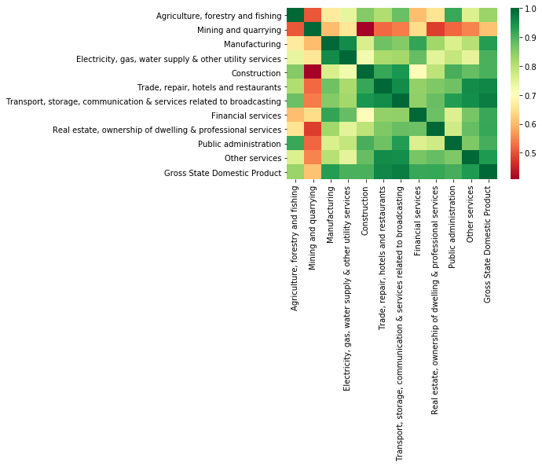
Plot correlation between sub-sectors (Duration – 2014-15)
Observations:-
Focus on below 2 sub-sector because of strong correlation
Transport, storage, communication & services related to broadcasting
Trade, repair, hotels and restaurants
Weak correlation with “Mining and quarrying” sub-sector.
Sub-Sector | Correlation
Transport, storage, communication & services related to broadcasting | 0.97
Trade, repair, hotels and restaurants | 0.96
Other services | 0.94
Manufacturing | 0.93
Real estate, ownership of dwelling & professional services | 0.92
Financial services | 0.92
Public administration | 0.91
Construction | 0.90
Electricity, gas, water supply & other utility services | 0.90
Agriculture, forestry and fishing | 0.83
Mining and quarrying | 0.61

Slide 13
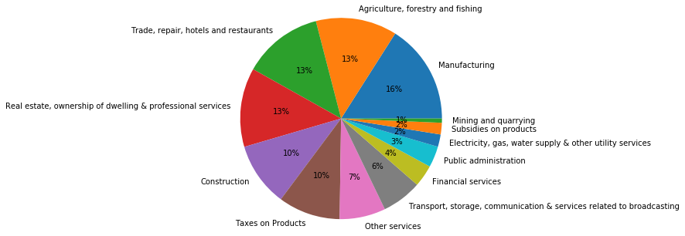
% Contribution of sub-sectors for C1 Category (Category1 - Greater than 85 percentile) C1 Category states – Goa, Sikkim, Haryana, Kerala, Uttarakhand Duration – 2014-15
These top 6 sub-sectors contribute to approximately 80% of the GDP
Manufacturing
Agriculture, forestry and fishing
Trade, repair, hotels and restaurants
Real estate, ownership of dwelling & professional services
Construction
Other services
Recommendation –
Focus on “Real estate, ownership of dwelling & professional services” since it has strong correlation and contributes significantly to GDP.
Increased focus “Trade, repair, hotels and restaurants” may result in higher per Capita GDP because of tourism.

Slide 14
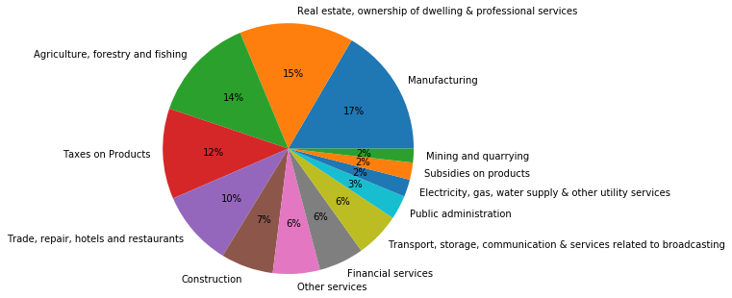
% Contribution of sub-sectors for C2 Category (Category2 - Greater than 50 and Less than or equal to 85 percentile) C2 Category states – Maharashtra, Himachal Pradesh, Tamil Nadu, Karnataka, Gujarat, Telangana, Punjab, Arunachal Pradesh, Andhra Pradesh. Duration – 2014-15
These top 6 sub-sectors contribute to approximately 80% of the GDP
Manufacturing
Real estate, ownership of dwelling & professional services
Agriculture, forestry and fishing
Trade, repair, hotels and restaurants
Construction
Other services
Financial services
Recommendation –
Category 2 contributes most to the GDP but has lesser per Capita GDP because of population. With increasing population there is increased demand of housing. Focus on Real estate, ownership of dwelling & professional services may boost per Capita GDP.
Continued focus on Manufacturing because of strong correlation with GDP.
Increased focus on “Trade, repair, hotels and restaurants” may results in higher per Capita GDP because of spending capacity of people and higher correlation.

Slide 15
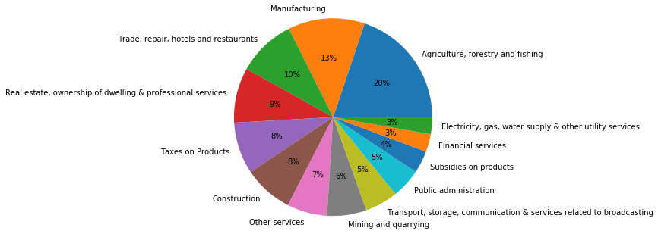
% Contribution of sub-sectors for C3 Category (Category3 - Greater than 20 and Less than or equal to 50 percentile) C3 Category states – Mizoram, Nagaland, Chhattisgarh, Rajasthan, Tripura, Meghalaya, Jammu Kashmir, Odisha Duration – 2014-15
These top 6 sub-sectors contribute to approximately 80% of the GDP
Agriculture, forestry and fishing
Manufacturing
Trade, repair, hotels and restaurants
Real estate, ownership of dwelling & professional services
Construction
Other services
Mining and quarrying
Recommendation –
Continued focus on “Agriculture, forestry and fishing” sub-sector because of higher contribution to GDP and strong correlation with GDP.
Increase focus on Tertiary sector (Real estate, ownership of dwelling & professional services ) may result in higher GDP and thus higher per Capita GDP.
Increase focus on “Construction “ sub-sector because of strong correlation with GDP.
Highest subsidies on product resulting in loss of GDP.

Slide 16
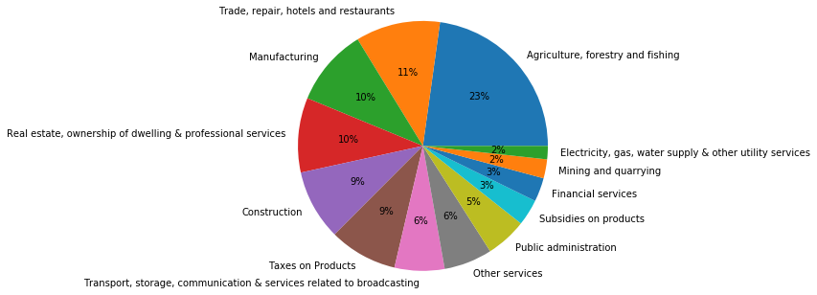
% Contribution of sub-sectors for C4 Category (Category4 - Less than or equal to 20 percentile) C4 Category states – Madhya Pradesh, Jharkhand, Assam, Manipur, Uttar Pradesh, Bihar Duration – 2014-15
These top 6 sub-sectors contribute to approximately 80% of the GDP
Agriculture, forestry and fishing
Trade, repair, hotels and restaurants
Manufacturing
Real estate, ownership of dwelling & professional services
Construction
Transport, storage, communication & services related to broadcasting
Recommendation –
Increased focus on “Construction” sub-sector because of contribution to GDP and strong correlation.
Most of the GDP is driven by Agriculture, Forestry and Fishing. Diversification is needed to increase the employment opportunity and mitigate risk.
Focus on sectors like Manufacturing, Real estate, ownership of dwelling & professional services will increase per Capita GDP.
Reduce focus from “Mining and quarrying” sub-sector since it does not contribute significantly to GDP and has negative correlation.

Slide 17
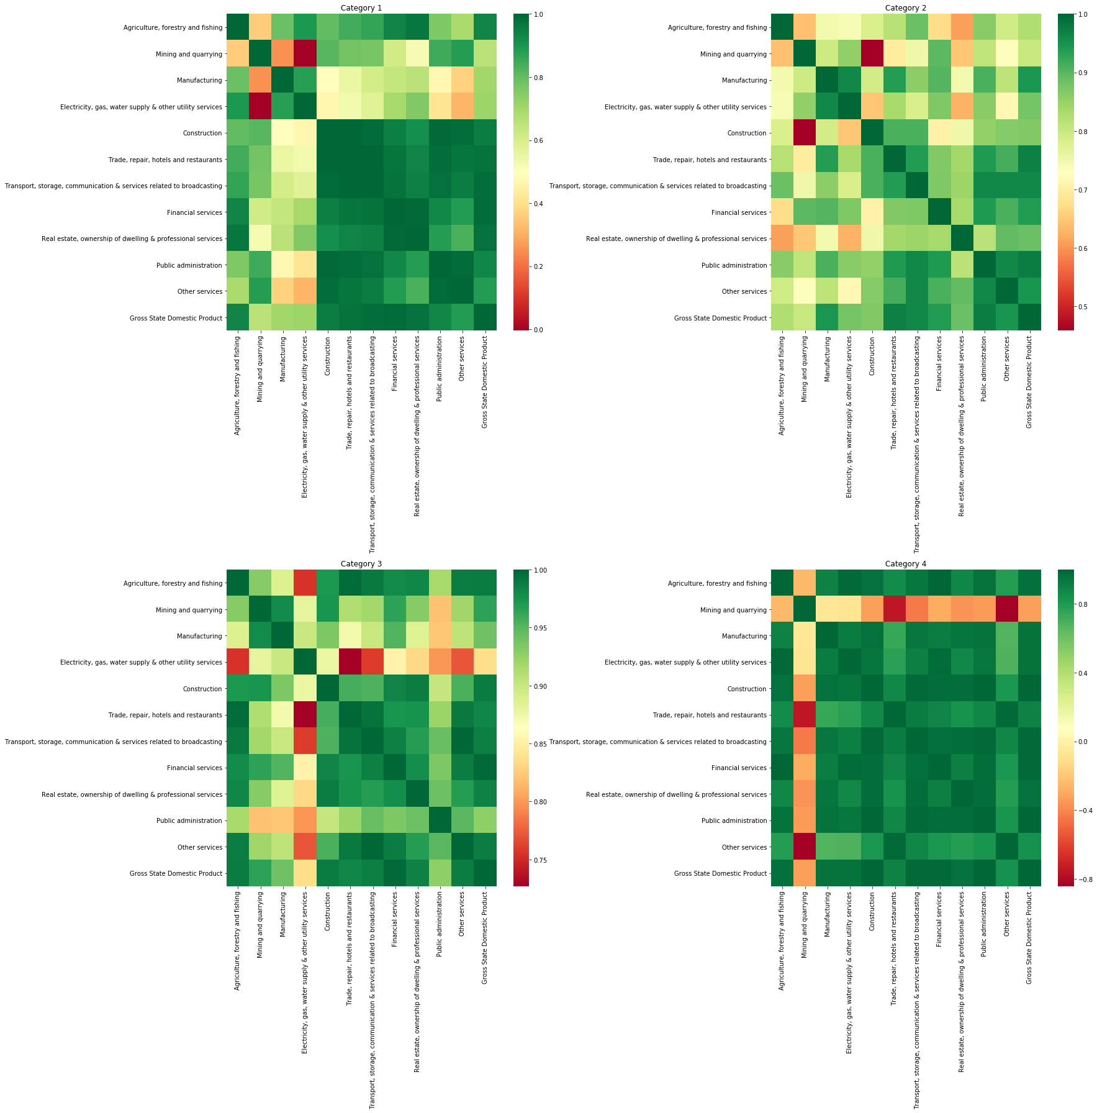
Plot correlation between sub-sectors (Duration – 2014-15)
Observations:-
Focus on below 2 sub-sector because of strong correlation
Transport, storage, communication & services related to broadcasting
Trade, repair, hotels and restaurants
Weak correlation with “Mining and quarrying” sub-sector.

Slide 18
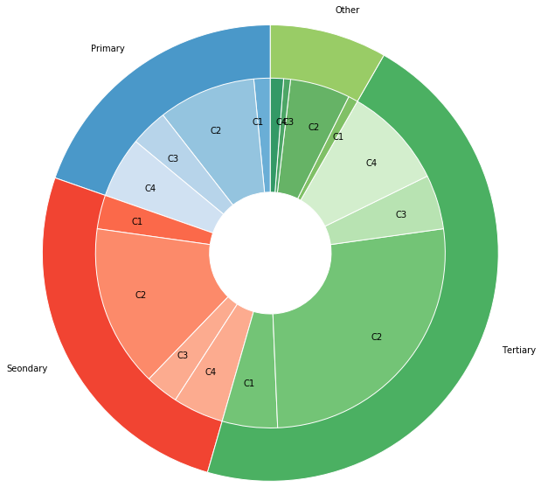
Observations
“Manufacturing” is major contributor in GDP for states in Category 1 as well as Category 2(Higher Per Capita GDP).
“Agriculture, forestry and fishing” is major contributor in GDP for states in Category 3 and Category 4.
Category 2 contributes most towards the GDP however because of population category’s Per Capita GDP is down.
States should continue to focus on “Manufacturing” and “Trade, repair, hotels and restaurants Manufacturing“ sub-sectors because
They play major contribution to total GDP
Strong correlation with GDP
% Contribution by each
Category to Sector
Legends
C1 = Category 1
C2 = Category 2
C3 = Category 3
C4 = Category 4

Slide 19
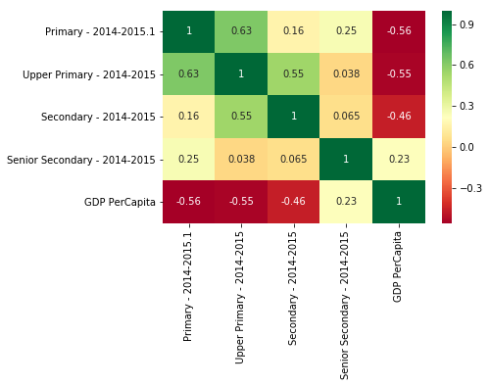
Dropout rates for education and Per Capita GDP – 2014-2015
Per Capita GDP is strongly impacted by dropout for Primary, Upper Primary and Secondary education. Increase in dropout rates results in decrease in Per Capita GDP.
Senior Secondary education has slight correlation with Per Capita GDP.
Dropouts from senior secondary potentially start contributing towards the GDP and hence we see positive correlation.
Note - Primary 2014-2015 occurs twice in the data. This appears to be Typo - First occurrence appears to be Primary 2013-2014. We will ignore the first occurrence and consider second occurrence (Primary - 2014-2015.1) for our processing

Slide 20
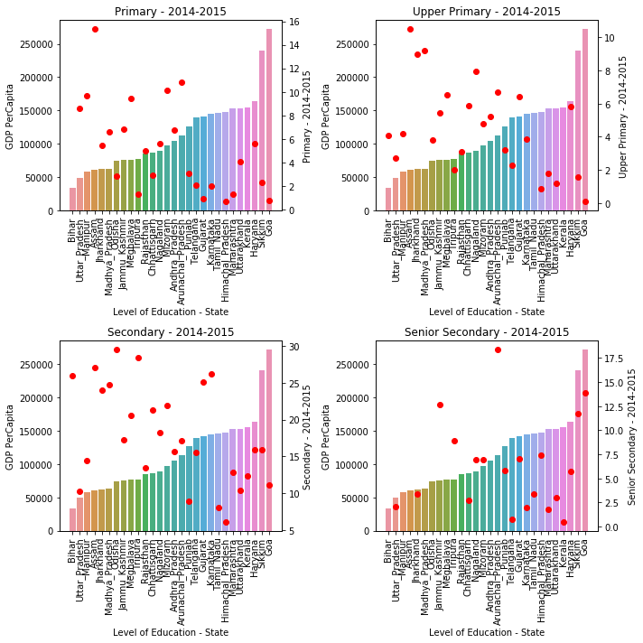
Dropout rates for Education vs Per Capita GDP – 2014-2015
Red dot denotes the dropout rate.
Lower dropout indicates educated population resulting in good employment opportunities.
Higher the per capita GDP is observed for Primary, Upper Primary and Secondary because of the employment opportunity.
For senior secondary, as dropout rate increases the Per Capita GDP also increases.

Slide 21
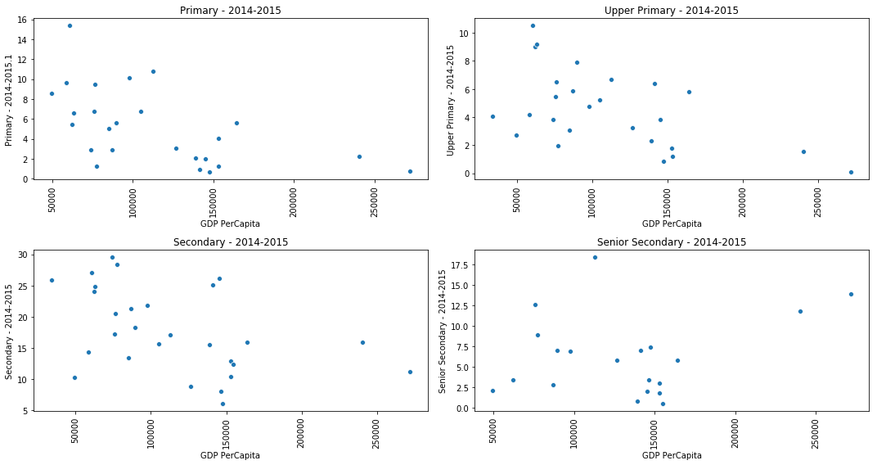
Dropout rates for Education vs Per Capita GDP – 2014-2015

Slide 22
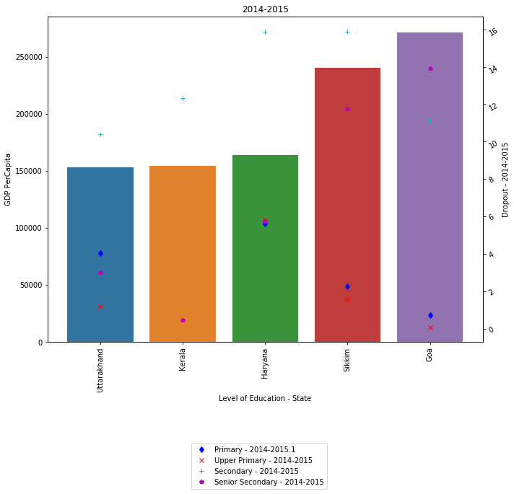
Dropout rates vs Per Capita (2014-15) – Category 1
Low dropout rate for Primary and Upper Primary education
High dropout rate for Secondary and Senior Secondary.
Summary:
Education Level | Average Dropout
Primary - 2014-2015 | 3.16
Upper Primary - 2014-2015 | 2.16
Secondary - 2014-2015 | 13.13
Senior Secondary - 2014-2015 | 6.98
GDP PerCapita | 196799.6

Slide 23
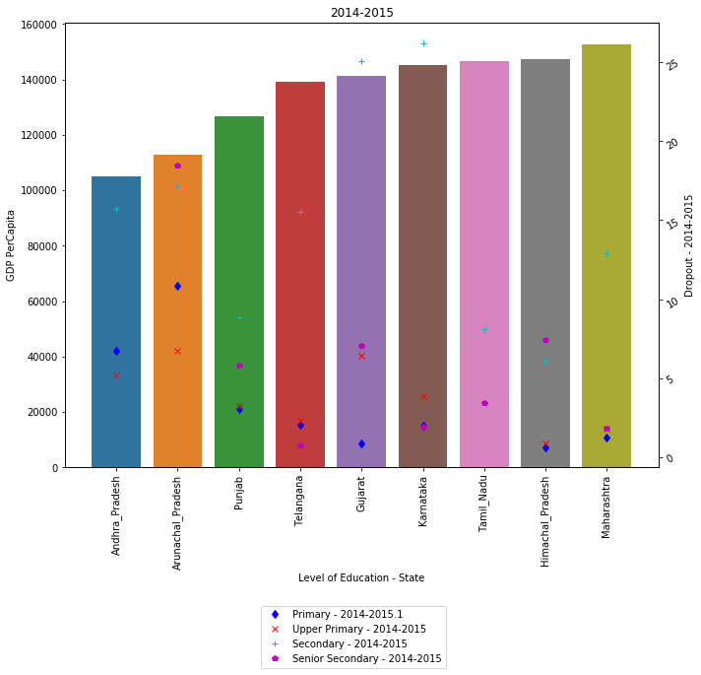
Dropout rates vs Per Capita (2014-15) – Category 2
Drop out rates for category C2 is greater than category C1.
Low dropout rate for Primary and Upper Primary education
High dropout rate for Secondary and Senior Secondary.
Summary:
Education Level | Average Dropout
Primary - 2014-2015 | 3.44
Upper Primary - 2014-2015 | 3.79
Secondary - 2014-2015 | 15.05
Senior Secondary - 2014-2015 | 5.83
GDP PerCapita | 135158.44

Slide 24
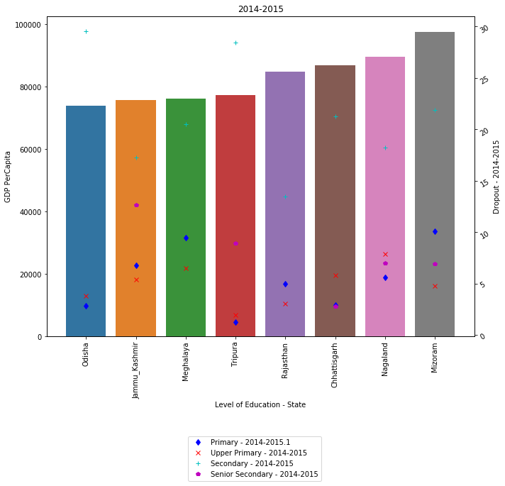
Dropout rates vs Per Capita (2014-15) – Category 3
Drop out rates for category C3 is greater than category C3.
Dropout rate for Primary significantly greater than Upper Primary.
High dropout rate for Secondary and Senior Secondary.
Summary:
Education Level | Average Dropout
Primary - 2014-2015 | 5.50
Upper Primary - 2014-2015 | 4.92
Secondary - 2014-2015 | 21.33
Senior Secondary - 2014-2015 | 7.64
GDP PerCapita | 82799.50

Slide 25
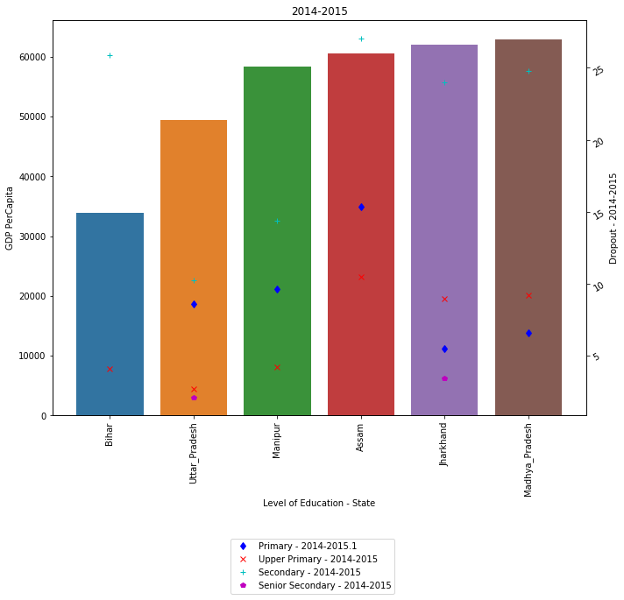
Dropout rates vs Per Capita (2014-15) – Category 4
Low dropout rate for Primary and Upper Primary education
High dropout rate for Secondary and Senior Secondary.
Summary:
Education Level | Average Dropout
Primary - 2014-2015 | 9.13
Upper Primary - 2014-2015 | 6.61
Secondary - 2014-2015 | 21.05
Senior Secondary - 2014-2015 | 2.76
GDP PerCapita | 54591.17

Slide 26
Dropout Rate Comparison
C1 Category |  |  | C2 Category
Education Level | Average Dropout |  | Education Level | Average Dropout
Primary - 2014-2015 | 3.16 |  | Primary - 2014-2015 | 3.44
Upper Primary - 2014-2015 | 2.16 |  | Upper Primary - 2014-2015 | 3.79
Secondary - 2014-2015 | 13.13 |  | Secondary - 2014-2015 | 15.05
Senior Secondary - 2014-2015 | 6.98 |  | Senior Secondary - 2014-2015 | 5.83
GDP PerCapita | 196799.6 |  | GDP PerCapita | 135158.44
C3 Category |  |  | C4 Category
Education Level | Average Dropout |  | Education Level | Average Dropout
Primary - 2014-2015 | 5.87 |  | Primary - 2014-2015 | 9.13
Upper Primary - 2014-2015 | 4.79 |  | Upper Primary - 2014-2015 | 6.61
Secondary - 2014-2015 | 21.34 |  | Secondary - 2014-2015 | 21.05
Senior Secondary - 2014-2015 | 8.86 |  | Senior Secondary - 2014-2015 | 2.76
GDP PerCapita | 82219.43 |  | GDP PerCapita | 54591.17

Slide 27
Hypothesis – Education Dropout Rate
Decrease in dropout rate for Primary and Upper primary results in increase in Per Capita GDP. It can be inferred that this attributes to qualified individuals contributing greatly to GDP, predominantly Tertiary and Secondary sector.
Higher dropout rate for Higher secondary does not impact Per Capita GDP since they can start contributing to GDP.
Dropout for Secondary level is highest and is consistent across categories. Categories/States with high secondary drop out rates show majority of their contribution to GDP coming from “Agriculture, forestry and fishing“ sub-sector.
Reducing dropout rates for category3 and category4 will result in higher GDP based on data analyzed.

Slide 28
Summary
Entire analyses and plots are done using Python3.
West Bengal data is missing and hence excluded from analysis.
Data is not imputed for missing values since it might lead to discrepancy.
Education dropout is pressing issue for Category 3 and category 4.
Bottom 5/6 sub-sectors contribute only 20% to GDP based on analysis done for 2014-15.

